Slide 1

Algorithms and Data Structures 1 CS 0445
Fall 2023
Simple Sorting Algorithms
Sherif Khattab
ksm73@pitt.edu
(Slides are adapted from Dr. Ramirez’s and Dr. Farnan’s CS 0445 slides.)

Slide 2
Announcements
Upcoming Deadlines:
Homework 8: Tuesday 11/7 @ 11:59 pm
Midterm Questions Redo: Tues. 11/7 @ 11:59 pm
up to 7 points back
Lab 5: Friday 11/3 @ 11:59 pm
Programming Assignment 4: Friday 11/10 @ 11:59 pm

Slide 3
StringBuilder
StringBuilder is mutable, whereas String is immutable
Internally, a resizable array is used
Appending to StringBuilder is O(1)
appending to String is O(n)
StringBuilder sb = new StringBuilder(“Hello”);
sb.append(“!”); //O(1)
String s = new String(“Hello”);
s = s + “!”; //O(n)

Slide 4
Debugging a program with command-line arguments
In VSCode, edit launch.json to add an “args” to the run configuration for the program

Slide 5
When to use recursion?
recursion is more natural and simpler
extremely difficult to even conceive an iterative approach
recursion allows for a more efficient solution

Slide 6
Limitations of Recursion
Recursion Overhead is high
Recursion may lead a less efficient solution than an iterative approach

Slide 7
Overhead of Recursion
Recursive calls have overhead
Space: each activation record (AR) takes up memory in the run-time stack (RTS)
If too many calls "stack up,” memory can be a problem
Time: generating ARs and manipulating the RTS takes time
A recursive algorithm will always run more slowly than an equivalent iterative version
Once a recursive algorithm is developed, in some cases we can convert it into a faster iterative version

Slide 8
Tail Recursion
When recursive call is the last statement of the method
No further processing after the return of the recursive call
Some algorithms we have seen so far are tail recursive and some are not

Slide 9
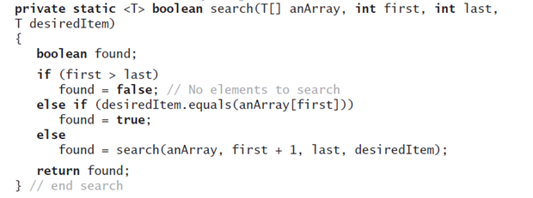
Tail-recursive?

Slide 10
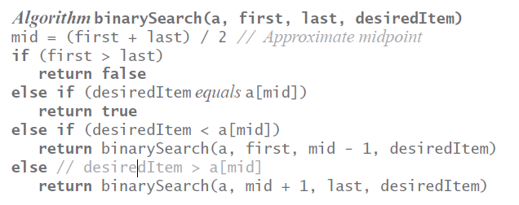
Tail-recursive?

Slide 11
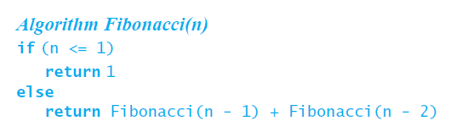
Tail-recursive?

Slide 12
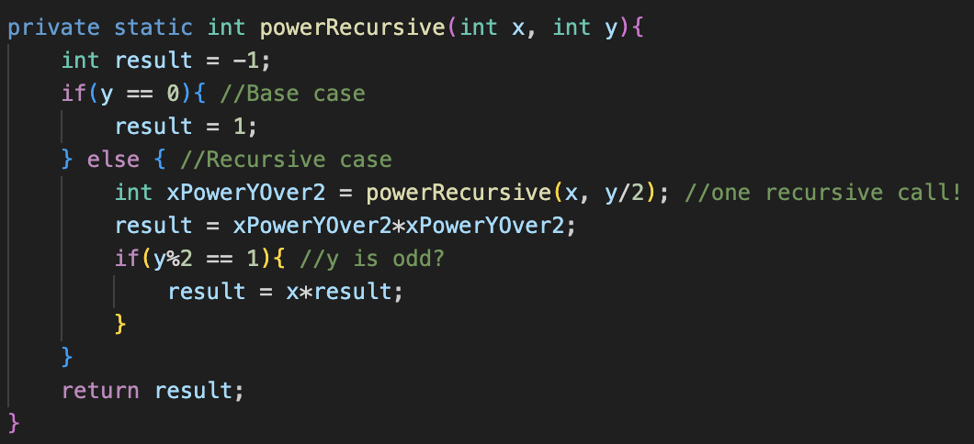
Tail-recursive?

Slide 13
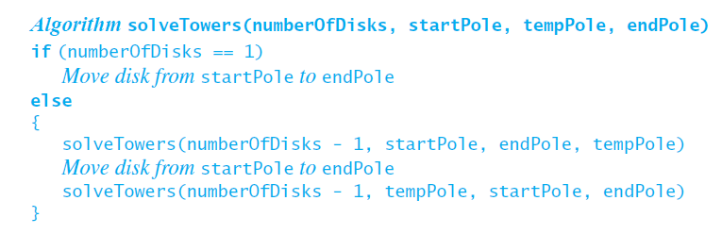
Tail-recursive?

Slide 14
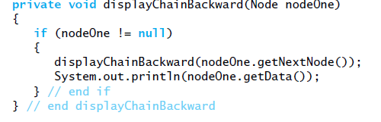
Tail-recursive?

Slide 15
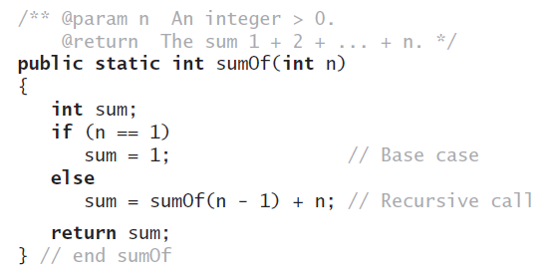
Tail-recursive?

Slide 16
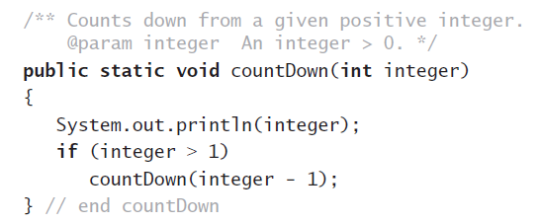
Tail-recursive?

Slide 17
Implications of Tail Recursion
Any tail recursive algorithm can be converted into an iterative algorithm in a systematic way
some compilers do that automatically

Slide 18
Converting Tail Recursion into Iteration
Step 1: make the recursive call inside an if statement
Step 2: change the if statement to a while loop
Step 3: replace the recursive call by a set of assignment statements in the form
parameter = argument

Slide 19
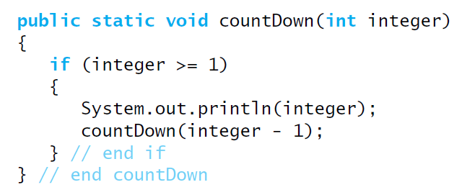
Example
Step 1: Put the recursive call inside an if statement
Public static void countdown(int integer){
if(integer == 1)
System.out.println(integer);
else
countdown(integer-1);
}

Slide 20
Example
Step 2: Convert if to while

Slide 21




Example
Step 3: replace recursive call by assignment statement(s)
parameter = argument
integer = integer -1

Slide 22
Example 2: Towers of Hanoi

Slide 23
Converting Recursion to Iteration using an Explicit Stack
We can convert recursion into iteration by replacing the Runtime Stack with an explicit Stack
Basic idea: replace recursive call by push to stack
Example: Lab 5

Slide 24
Final Note on Runtime Analysis of Recursive Algorithms
In general, we can either use proof by induction or recursion tree in most of the cases
Please check more examples on Canvas

Slide 25
Sorting
We have seen a few container data structures
Bag, Stack, List
Sorting Problem: Given a list of n items, order items such that entry 1 ≤ entry 2 ≤ . . . ≤ entry n
This is ascending order
Can also order in descending order

Slide 26
Building Blocks of Comparison Sorting
1. Compare
boolean <T> less(Comparable<T> v, Comparable<T> w) {
return (v.compareTo(w) < 0);
}
2. Swap
void exch(Object[] a, int i, int j) {
Object swap = a[i];
a[i] = a[j];
a[j] = swap;
}

Slide 27
Sorting Algorithms
Efficiency of sorting algorithm is significant
O(n²)
Bubble Sort
Selection Sort
Insertion Sort
Shell Sort
O(n log n)
Merge Sort
Quick Sort
O(n)
Radix Sort (doesn’t use data comparisons)

Slide 28
Sorting Algorithms: Plan
understand the main concept using an example
implement the algorithm
on an Array
Iterative
recursive
on a linked list
iterative
recursive
Sorting an array is usually easier than sorting a chain

Slide 29
Bubble sort
Go through the array comparing pairs of items, swap them if they are out of order
Repeat until you make it through the array with 0 swaps
void bubbleSort(Comparable[] a) {
boolean swapped;
do {
swapped = false;
for(int j = 1; j < a.length; j++) {
if (less(a[j], a[j-1]))
{ exch(a, j-1, j); swapped = true; }
}
} while(swapped);
}
Notes:
grey
t₃
1
yellow
t₂
x (x varies from 0 .. n)
red
t₁
sum i=1 to x (sum j=1 to n (1))
= n² (assuming x == n)
purple
t₀
y (y varies from 0 .. n²)

Slide 30
Bubble sort example
SWAPPED!
1
5
3
3
5
3
1
4
1
4
5
4
1
5
10

Slide 31
“Improved” bubble sort
void bubbleSort(Comparable[] a) {
boolean swapped;
int to_sort = a.length;
do {
swapped = false;
for(int j = 1; j < to_sort; j++) {
if (less(a[j], a[j-1]))
{ exch(a, j-1, j); swapped = true; }
}
to_sort--;
} while(swapped);
}
Notes:
grey
t₃
1
yellow
t₂
x (x varies from 0 .. n)
red
t₁
sum i=1 to x (sum j=1 to n-i (1))
= n²/2 - n/2 (assuming x == n)
purple
t₀
y (y varies from 0 .. n²/2 - n/2)

Slide 32
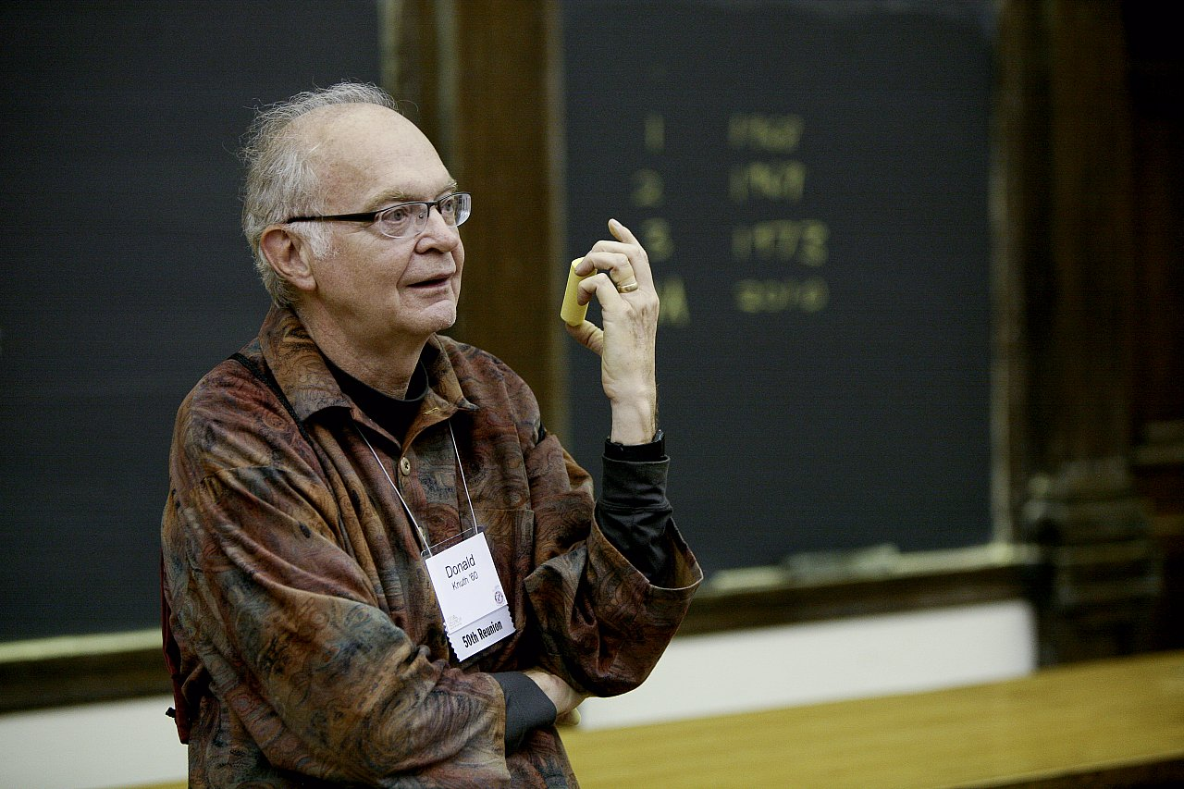
How bad is it?
Runtime:
O(n²)
"[A]lthough the techniques used in the calculations [to analyze the bubble sort] are instructive, the results are disappointing since they tell us that the bubble sort isn't really very good at all."
Donald Knuth
The Art of Computer Programming

Slide 33
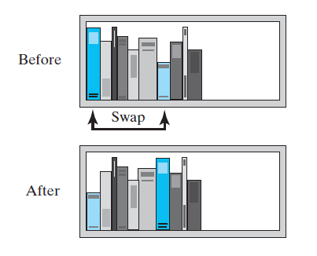
Selection Sort
Basic Idea: In iteration i, find smallest item in sublist (i, n-1) and swap it with item at position i
iteration 0:
Find smallest item in subarray (0, n-1)
Swap with item at 0

Slide 34
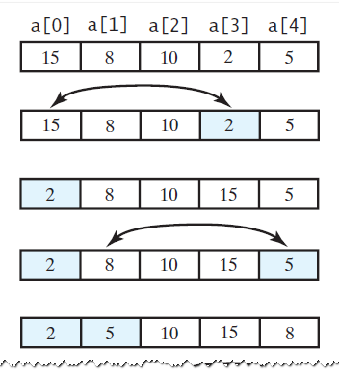
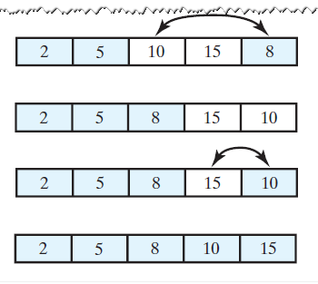
Selection Sort Example

Slide 35
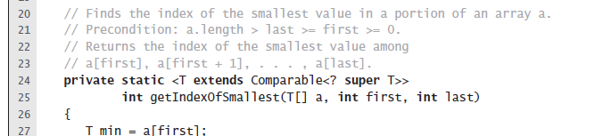
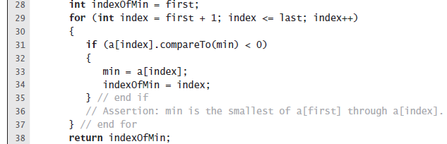
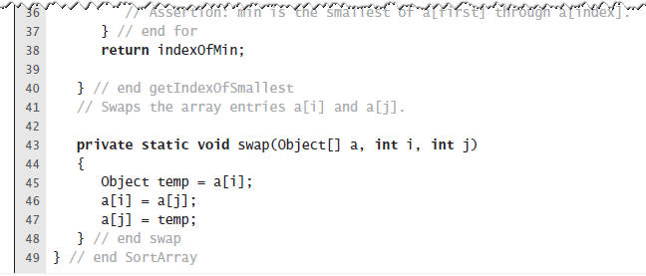
Find Smallest Item in a sublist

Slide 36
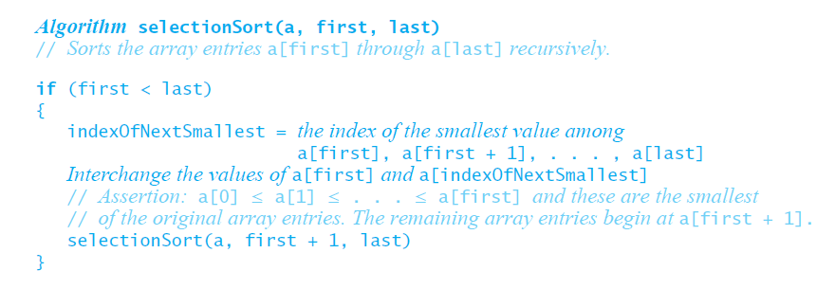
Recursive Selection Sort

Slide 37
Efficiency of Selection Sort
Selection sort is O(n²) regardless of the initial order of the entries.
Requires O(n²) comparisons
Does only O(n) swaps

